Slide 1
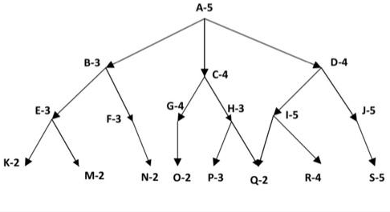
Best First Search
Below graph shows state space with heuristic evaluations attached to each of the states. Smaller number for the heuristic is considered better. Use Best First Search algorithm to find the least cost path that leads to the goal state Q. Evaluate immediate child states of a parent state from left to right. Show the below lists for each iteration.
Maintain "open" as the sorted list of states (priority queue) to record frontier of the current search.
"closed" list records states that are already considered.
In order to be able to trace the path to the goal, you should either maintain a separate "State List" or maintain ancestor information within "open" and "closed" lists as ancestor and child pair.

Slide 2

Best first search (BFS) is a search algorithm that a particular rule and uses a priority queue and heuristic search. It is ideal for computers to evaluate the appropriate and shortest path through a maze of possibilities. Suppose you get stuck in a big maze and do not know how and where to exit quickly. Here, the best first search in AI aids your system program in evaluating and choosing the right path at every succeeding step to reach the goal as quickly as possible.

Slide 3

A* Search:
It is a search algorithm used to find the shortest path between an initial and a final point. It is often used for map traversal to find the shortest path. A* was initially designed as a graph traversal problem to help build a robot that can find its own course. It remains a widely popular algorithm for graph traversal.
It searches for shorter paths first, thus making it an optimal and complete algorithm. An optimal algorithm will find the least cost outcome for a problem, while a complete algorithm finds all the possible outcomes of a problem.
Another aspect that makes A* so powerful is its implementation of weighted graphs. A weighted graph uses numbers to represent the cost of taking each path or course of action. This means that the algorithms can take the path with the least cost, and find the best route in terms of distance and time.

Slide 4


